Slide 1


Slide 2
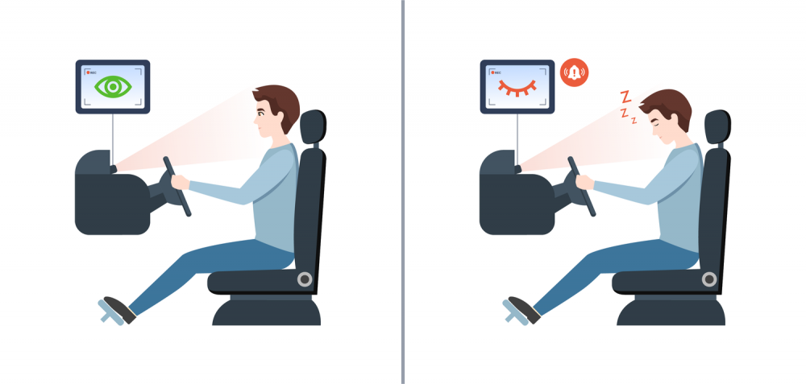
INTRODUCTION
In the realm of road safety, driving fatigue stands out as a significant contributor to accidents.
Acknowledging this challenge, we present our innovative solution the Drowsiness Alert System.
A proactive approach to enhancing driver safety, this system employs real-time monitoring through cutting-edge facial recognition and eye-tracking technology.
By promptly detecting signs of drowsiness, it provides immediate alerts, ensuring a safer and more secure driving experience.

Slide 3
SURVEY
21 percent of all fatal accidents are due to drowsy driving.60 percent of adult drivers or about 168 million people have driven a vehicle while feeling drowsy in the past year.
About 37 percent or 103 million people have fallen asleep at the wheel, according to the National Sleep Foundation's [NSF] 2005 poll.4 percent or approximately eleven million drivers admit they have had an accident or near accident because they dozed off or were too tired to drive.
Sleepiness while driving contributes to 3% to > 30% of all road traffic accidents globally, which may involve a variety of sleep conditions but also may be caused by sleep deprivation.
More than 20% of the drivers feel a need to stop driving at least once due to sleepiness.
This systematic review was designed for a better understanding of the relationship between sleepiness and risk of road traffic accidents.

Slide 4
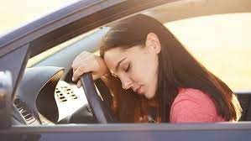
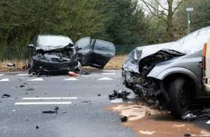
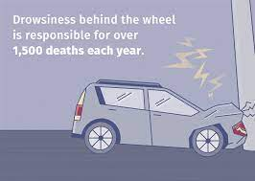
SURVEY

Slide 5
MODULES
OpenCV (Open Source Computer Vision Library): provides a wide range of functions for reading, manipulating videos. Object detection and tracking includes tools for detecting and tracking objects in images and videos. Useful for geometric camera calibration and 3D reconstruction.
Imutils: For image processing function, face_utils for facial recognition. Functions for easily resizing and rotating images.
Dlib : Dlib is well-known for its facial landmark detection capabilities, which involves identifying key points on a face. Dlib includes tools for machine learning, making it versatile for various applications.
SciPy: SciPy builds on NumPy and provides additional functionality for scientific computing. Statistical tools for hypothesis testing, regression, Euclidean distance and more.

Slide 6
SYSTEM DESIGN
Calculation of drowsiness using distance :
Eye Aspect Ratio (EAR) :
EAR = ||P0 - P3|| + ||P1 – P5|| + ||P2 – P4|| ….. where P1 …. P6 are the variation of eye length.
Setting the EAR threshold for drowsiness detection and the frame check value.
Initialize the face detector and shape predictor

Slide 7
SYSTEM DESIGN
Importing Libraries:
The code begins by importing necessary libraries for distance calculations (scipy.spatial), image processing (imutils), facial recognition (dlib), and computer vision tasks (cv2).
Defining Eye Aspect Ratio (EAR) Calculation:
The calculation function calculates the Eye Aspect Ratio (EAR) based on the distances between specific landmarks of the eyes.
Setting Thresholds:
Threshold values are defined for EAR (threshold_value) and the number of consecutive frames for drowsiness detection (check_frame).
Initializing Face Detector and Shape Predictor:
The code initializes a face detector and shape predictor from the dlib library using pre-trained models.

Slide 8
SYSTEM DESIGN
Defining Indices for Eye Landmarks:
Indices for facial landmarks corresponding to the left and right eyes are defined.
Opening Video Capture:
The default camera (usually webcam) is opened for video capture.
Initializing Flags:
A flag is initialized to keep track of consecutive frames with drowsiness.
Defining Alert Sound Function:
A function (play_sound) is defined to play an alert sound using winsound.
Main Loop (Frame Processing):
The main loop captures frames from the video feed and processes them.

Slide 9
SYSTEM DESIGN
Face Detection and Landmark Prediction:
Faces are detected in each frame, and facial landmarks are predicted using the shape predictor.
Eye Aspect Ratio Calculation:
The EAR is calculated for both the left and right eyes.
Drawing Contours:
Contours are drawn around the eyes based on convex hulls of the landmarks.
Drowsiness Detection:
If the average EAR is below the threshold or the head pose angle is beyond a threshold, a flag is incremented.
Alert Display and Sound:
If the consecutive frame count exceeds a certain value, a drowsiness alert is displayed on the frame, and an alert sound is played.

Slide 10


